Slide 1
Image to Text to Speech conversion with intonation using machine learning for regional language.
Under the guidance of Prof. Dr. Madhushankara. M
Submitted by:
Pooja C A – 201046012,
Karthik Ballullaya MK – 201046029,
K. Viswateja - 201046042

Slide 2
Preface
The objective of this project is to convert images to text and text to speech with intonation using machine learning for a regional language by classifying characters written in Kannada, a south Indian language. The characters are extracted from written documents, segmented, and processed using various image processing techniques using numpy and OpenCV. The dataset used is the Chars74k dataset. Classifiers have been implemented based on K Nearest Neighbors, Support Vector Machines, Inception V3 and Convolutional Neural Networks using OpenCV and Keras.

Slide 3

Introduction

Slide 4
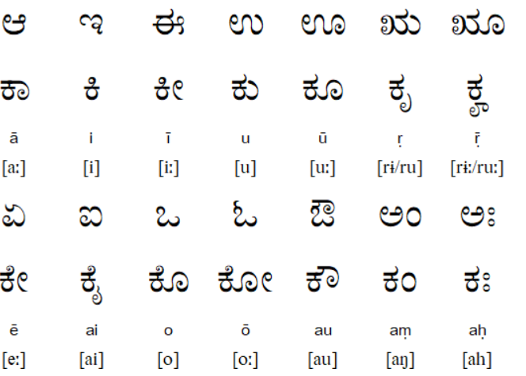
Kannada Language
Kannada ಕನ್ನಡ less commonly known as Kanarese) is a Dravidian language spoken predominantly by the people of Karnataka in south western region of India.

Slide 5
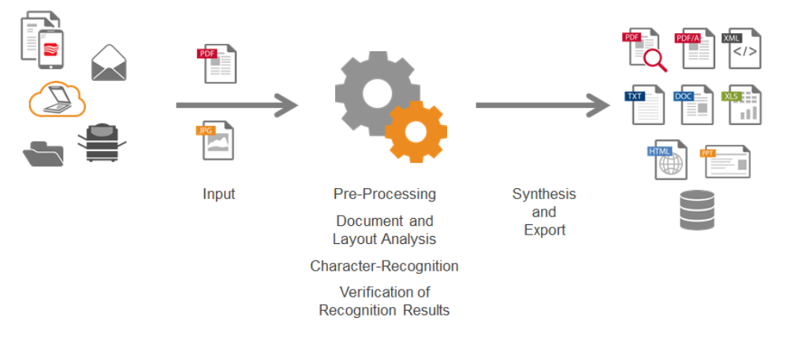
Optical character recognition (OCR)
Optical character recognition or optical character reader is the electronic or mechanical conversion of images of typed, handwritten or printed text into machine-encoded text, whether from a scanned document, a photo of a document, a scene-photo or from subtitle text superimposed on an image.

Slide 6
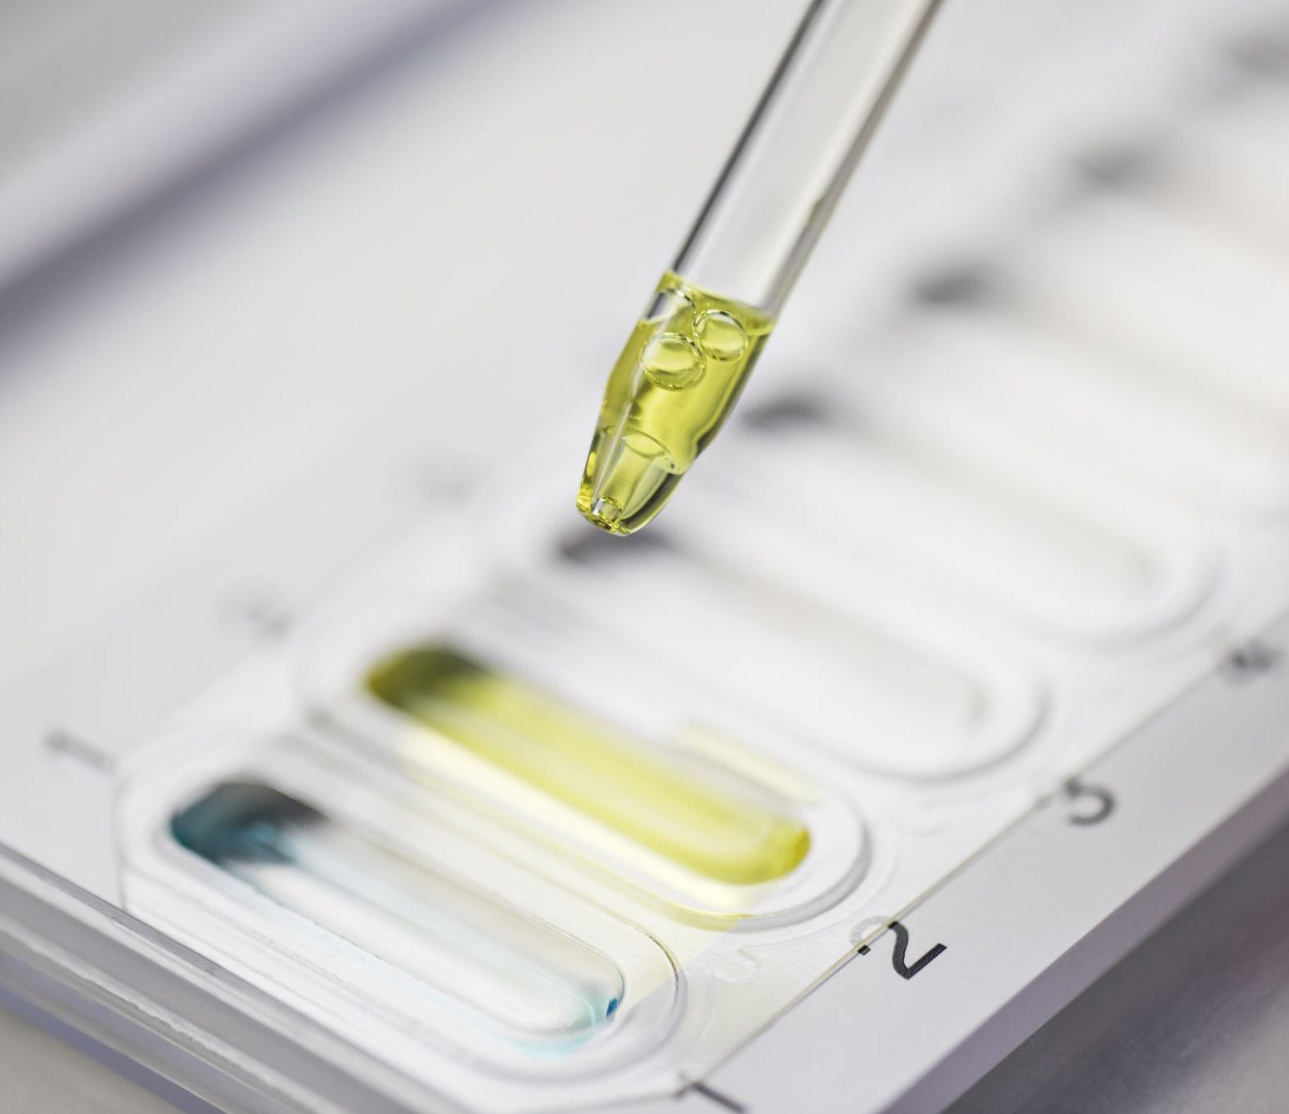
Char74K Dataset
Sample data

Slide 7
Char74K Dataset
Dataset has both handwritten and signs captured in them
657 classes.
Images include vowels, Consonants, conjunct consonants and Numerals.
Each class consist max 10 handwritten images.
Each image is of the dimension : 1200 x 900 pixels.
They are written with white background in black colour.

Slide 8
Preprocessing: Data augmentation
Technique used in increase the amount of data.
They can change the geometry, colour, scale, skew, rotation etc

Slide 9
Why Data augmentation is required
Deep learning techniques requires large amount of data.
With augmentation steps like rotate and adding noise to the image the learner can be very well generalized.

Slide 10
Work progress

Slide 11
Data preprocessing
Data augmentation:
Denoising the image
Adding Gaussian noise to image
Adding salt noise
Changing the contrast
Thinning the image contour
Rotation of image by +-15deg
Cropping the image
Adding Padding
Using these techniques, we have increased the dataset to 250 images per class

Slide 12

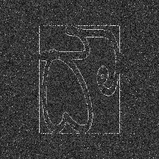
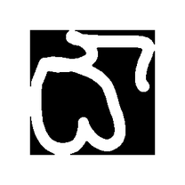
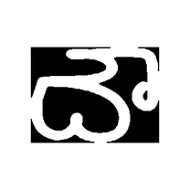
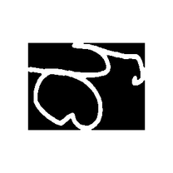
Results of data augmentation
Gaussian Noise
Rotate
Thinning
Change aspect

Slide 13
CNN learn Reading

Slide 14
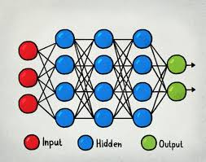
Neural networks

Slide 15
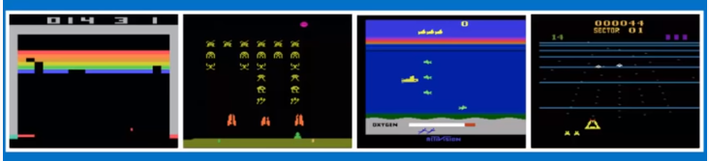
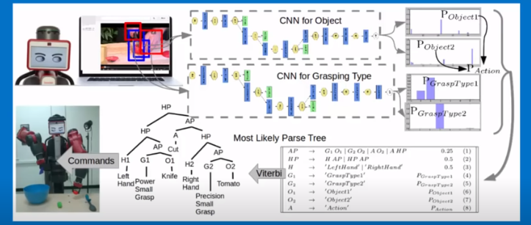
CNN

Slide 16

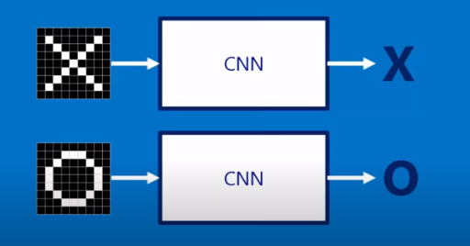

Slide 17
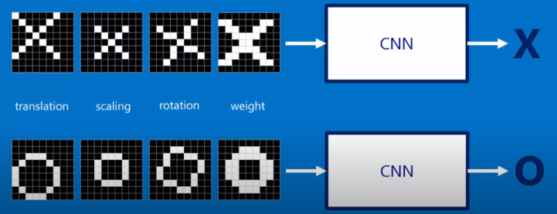

Slide 18
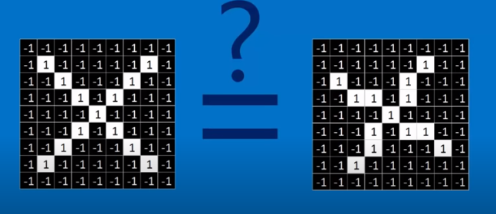

Slide 19
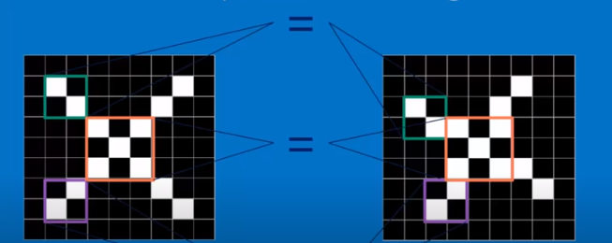

Slide 20
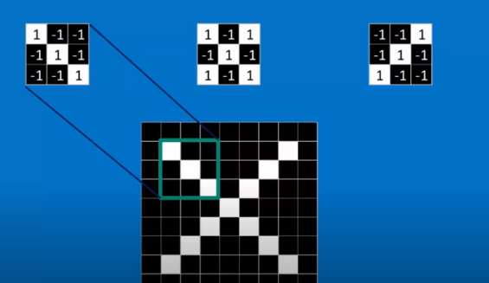

Slide 21
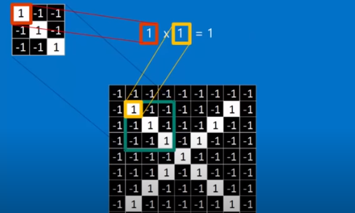
Convolution

Slide 22
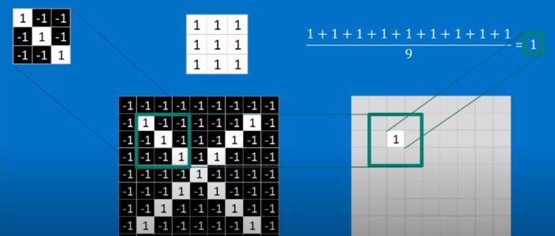

Slide 23
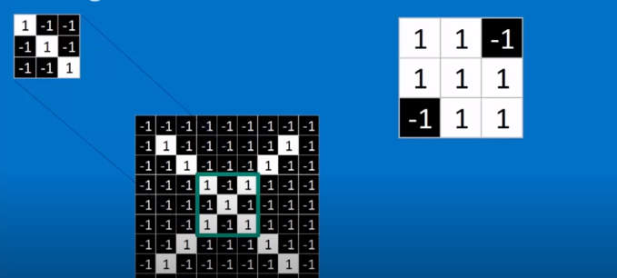

Slide 24
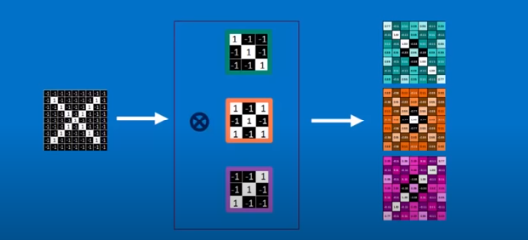
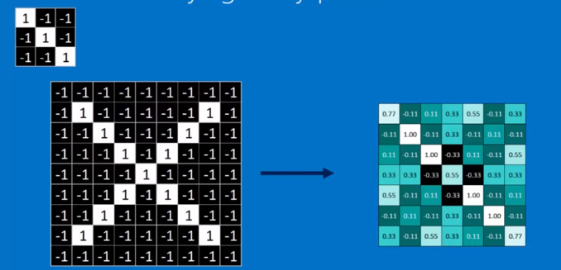

Slide 25
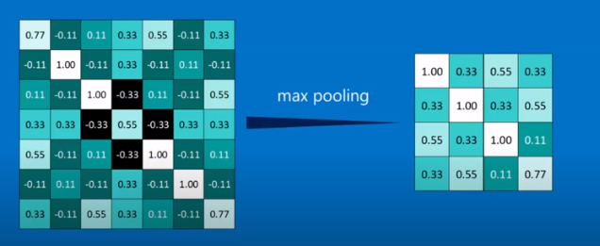
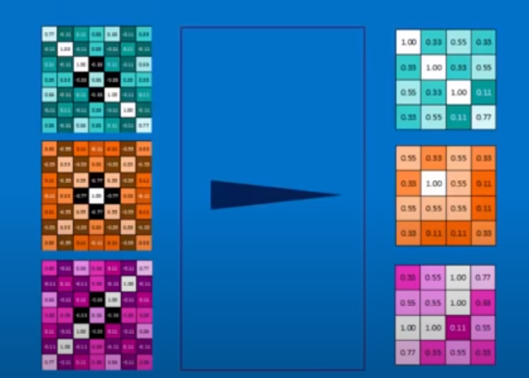
Pooling:

Slide 26
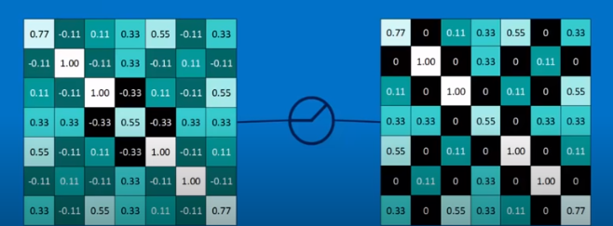
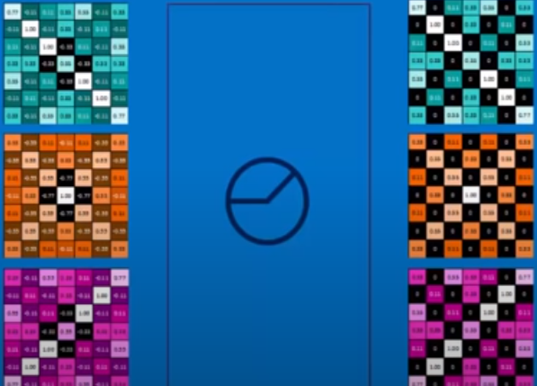
Rectified Linear Units:

Slide 27
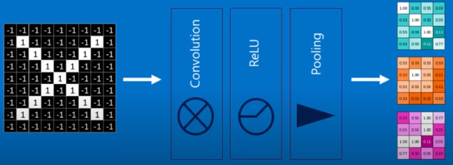
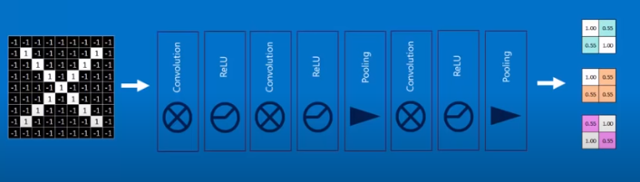

Slide 28
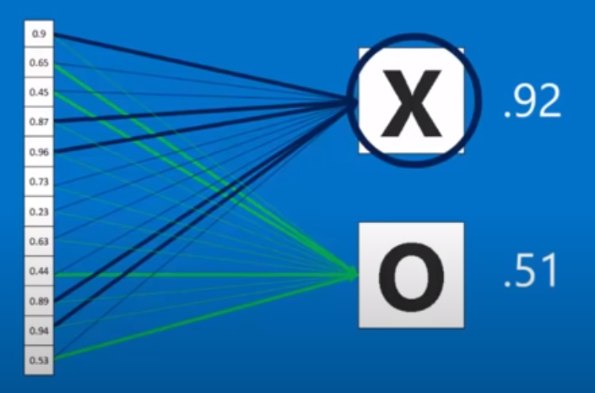

Slide 29
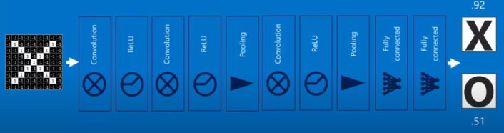
The complete CNN:

Slide 30
Further Work

Slide 31
Further Work
Experiment with different learning algorithms like CNN, SVM.
Create an interface for uploading the image and get the recognition.

Slide 32
References
http://www.ee.surrey.ac.uk/CVSSP/demos/chars74k/

Slide 33
Thank you

